Slide 1

Optimal use of renewable energy sources and energy consumption optimization in a building.
XVIII UCM MODELLING WEEK

Slide 2
Index
GMV
Background
The problem
Collaboration

Slide 3

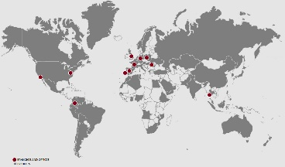


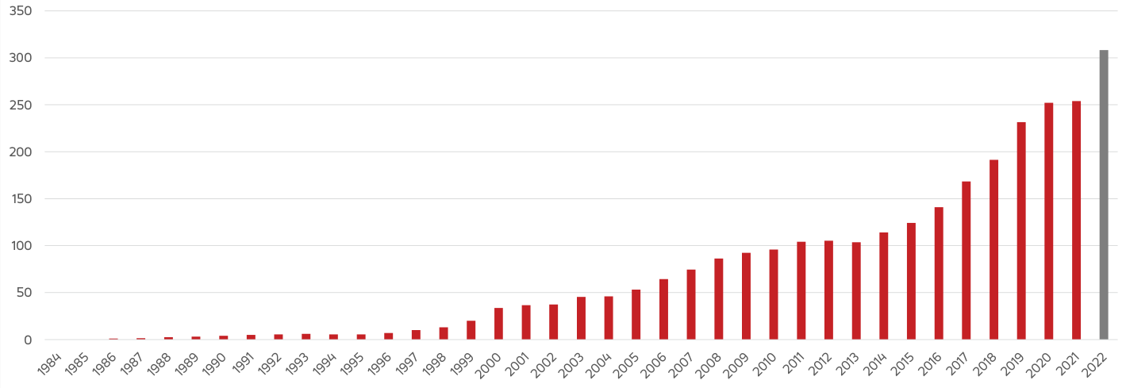

GMV: A global technology group
  MULTINATIONAL TECHNOLOGY
  Group
  Founded in
  1984
  Over 3.200
  employees
  Aeronautics, Space, Defense & Security, Cybersecurity, Intelligent Transport Systems, Healthcare, Banking & finances, and ICT industries
  Subsidiaries in 12 countries
  Roots tied to the Space
  industry
Revenues M€

Slide 4




Digital
Transformation
Cybersecurity
Innovation
© 2023 GMV Property – All rights reserved

Slide 5
International technology leadership
  #1 Worldwide Satellite Control Center provider to commercial telecom operators (+300 Satellite missions worldwide)
  First ever worldwide intraoperative radiotherapy planning system
  Responsible of safety critical systems of European GNSS systems (EGNOS and Galileo)
  Leader of Intelligent Transportation Systems for the public transport sector (+100 cities in Europe, Asia and America)
  GMV’s checker ATM security is the worldwide leader as multivendor cyber security protection for ATMs

Slide 6
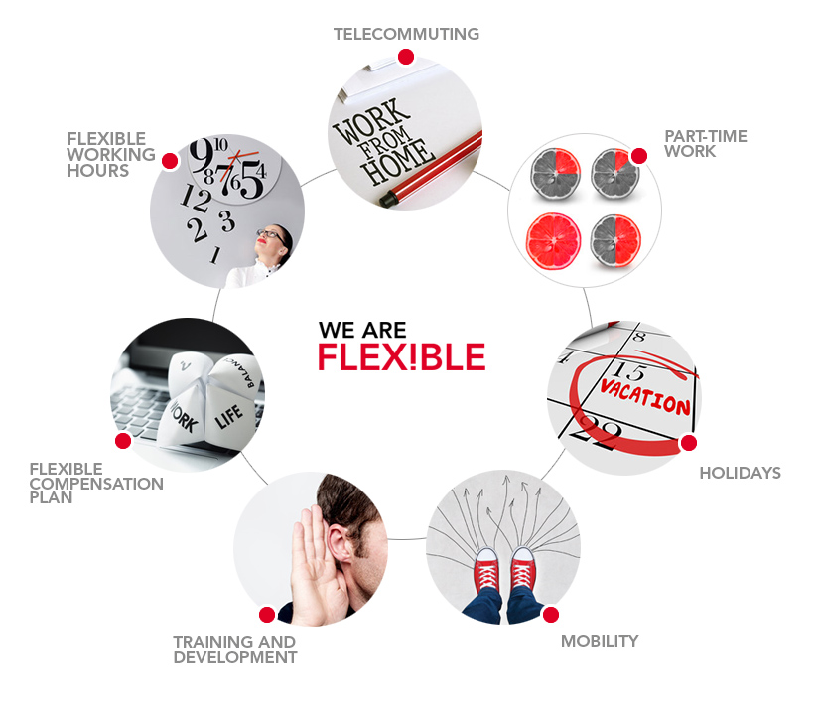




We are hiring
Check our positions at:
http://www.gmv.com/en/Employment/
Send your resume and academic record to: jobs@gmv.com
250+ open positions!
You can follow us:
https://www.facebook.com/infoGMV
https://twitter.com/infoGMV_es
https://www.linkedin.com/company/gmv
https://www.youtube.com/user/infoGMV

Slide 7
Background: GMV Project

Slide 8
Background
The Project
Problema:
    Optimización del uso de la refrigeración en una nave de distribución de frutas y verduras de una empresa de transporte española.
Objetivos:
    Adelantarse a la demanda frigorífica de la nave.
    Optimizar el coste energético de las máquinas enfriadoras.

Slide 9








Background
Datos de partida
Datos relacionados con la temperatura:
Datos relacionados con el coste:
Flujo de camiones
Flujo de productos
Calor producido
por equipo
Temperatura
interior
Coste
energético
Energía
Solar
Refrigerador
Batería

Slide 10
Background
Solución teórica
El problema de optimización se ha dividido a su vez en tres bloques:
    Predicción de la temperatura en el interior de la nave de distribución.
    Predicción del coste según la energía solar disponible.
    Optimización del uso del refrigerador.

Slide 11
The problem

Slide 12




The problem
Preparation
Firstly, we are going to work with 2 different data sources from the year 2023:
Building consumption: Dataset with the consumption of the building. Given by GMV.
Open-Meteo weather conditions data: This dataset is extracted by using Open-Meteo API, and it contains weather conditions from Tarifa.
REData for cost electricity: Data can be extracted by using REData API. It contains information of the cost of electricity by day.
Static conditions:
  Battery
  Solar panels

Slide 13

The problem
The study
We propose you, as first steps, to follow these guidelines:
Understand the idea and main concepts of the problem of energy consumption optimization.
Retrieve the problem information from APIs in order to complete the dataset.
Understand the information in the datasets, as well as their structure.
Adjust the datasets by determining which variables are relevant and what treatment/preprocessing should have each one of them.
Analyze the results, discuss the limitations, advantages, and potential of using renewable energies and the battery in the energy consumption problem.
We are interested in your study of most important variables for the optimization process, so maybe a simple dashboard or just a few graphs could make us very proud of you 😍

Slide 14
Collaboration

Slide 15


Collaboration
Team
Instructors
Pablo González | pagonzalez@gmv.com
Patricia Hernando | patricia.hernando.sanchez@gmv.com
Vanessa Navarro | vanessa.navarro.coronado@gmv.com
María Limones | mlimones@gmv.com
José Luis Álvarez | jlalvarez@gmv.com
Assistants

