Slide 1
Looking into the labels
Modelling week
June 2023

Slide 2
Introduction
PoC Objectives
PoC Deliverables
PoC technical requirements
Image characteristics
Some tips
Contact information

Slide 3
Introduction An important client of the retail sector dedicated to the sale of food products has contacted IBM to develop a new functionality that it wants to implement in its official App. The company wants to give quality information to its customers. That is why they want to use images of products they sell to make it easier for consumers to access and analyze the information present on the labels. During the negotiations it has been agreed to carry out a PoC (proof of concept) of duration one week to start developing some basic processes and create a project plan with a budget that the client can present internally to his superiors for approval. To meet the minimum requirements indicated by the customer, the selected team must be composed of Data Scientists with knowledge of NLP and Computer Vision. The results of this PoC will determine the success of the negotiations. The AI & Analytics team will face this challenge with two added difficulties: - Because the final project contract has not yet been signed, the client will not give access to its confidential database. - The customer has expressed the unavailability of resources at the hardware level (GPU).

Slide 4
PoC Objectives
Minimum requirements:
Part 1
In the customer database, there are marketing images, product images with different backgrounds and with different perspectives. For the new functionality, in the application, they want to show only product images that show a white background and show the label.
Label
Weight
White background
Resolution
Develop a solution that displays only images with a white background. It can be, for example,:
Classify images on white background/not white background Segment the image and put white background
Analyze advantages and disadvantages of the chosen solution.
Develop a solution that segments images between those with a product information label and those that do not. Analyze advantages and disadvantages of the chosen solution.
Classify images into high/medium and low resolution. Justify the chosen ranges. Recommend which ones to show in the application.
Classify images into high or low weight (in KB). Justify chosen ranks. Recommend which ones to show in the application.
Optional
Develop a solution to distinguish marketing images from product images taking into account GPU unavailability.

Slide 5
PoC Objectives
Minimum requirements:
Part 2
The ultimate goal of the new functionality to be developed is to extract the information from the labels of the products and show it to the user clearly. Labels have a series of mandatory fields that must always show and each field its own characteristics.
For this PoC the client has asked to extract the information from a minimum of fields.
Energy value
List of ingredients
Allergens
Develop a solution that extracts information from the label associated with the list of ingredients.
Develop a solution that extracts the information associated with the energy value per 100g and per serving (if any).
Develop a solution that extracts information from the label associated with the list of allergens.
Optional
Extract the information from the nutritional table present on the label Extract the information of the address or addresses present on the label.

Slide 6
PoC Deliverables
Part 1 Solution
Objectives achieved in the PoC vs Objectives for future project
Part Solution
Project proposal:
Required profiles Phases and tasks Time planning Project risks Technical requirements Budget
Solution architecture flow
Analysis of the inference times of the solutions

Slide 7
PoC technical requirements
The customer has expressed the unavailability of resources at the hardware level (GPU) For reasons of confidentiality, the client will not give access to its database. However, it has indicated the main characteristics of the image features.

Slide 8
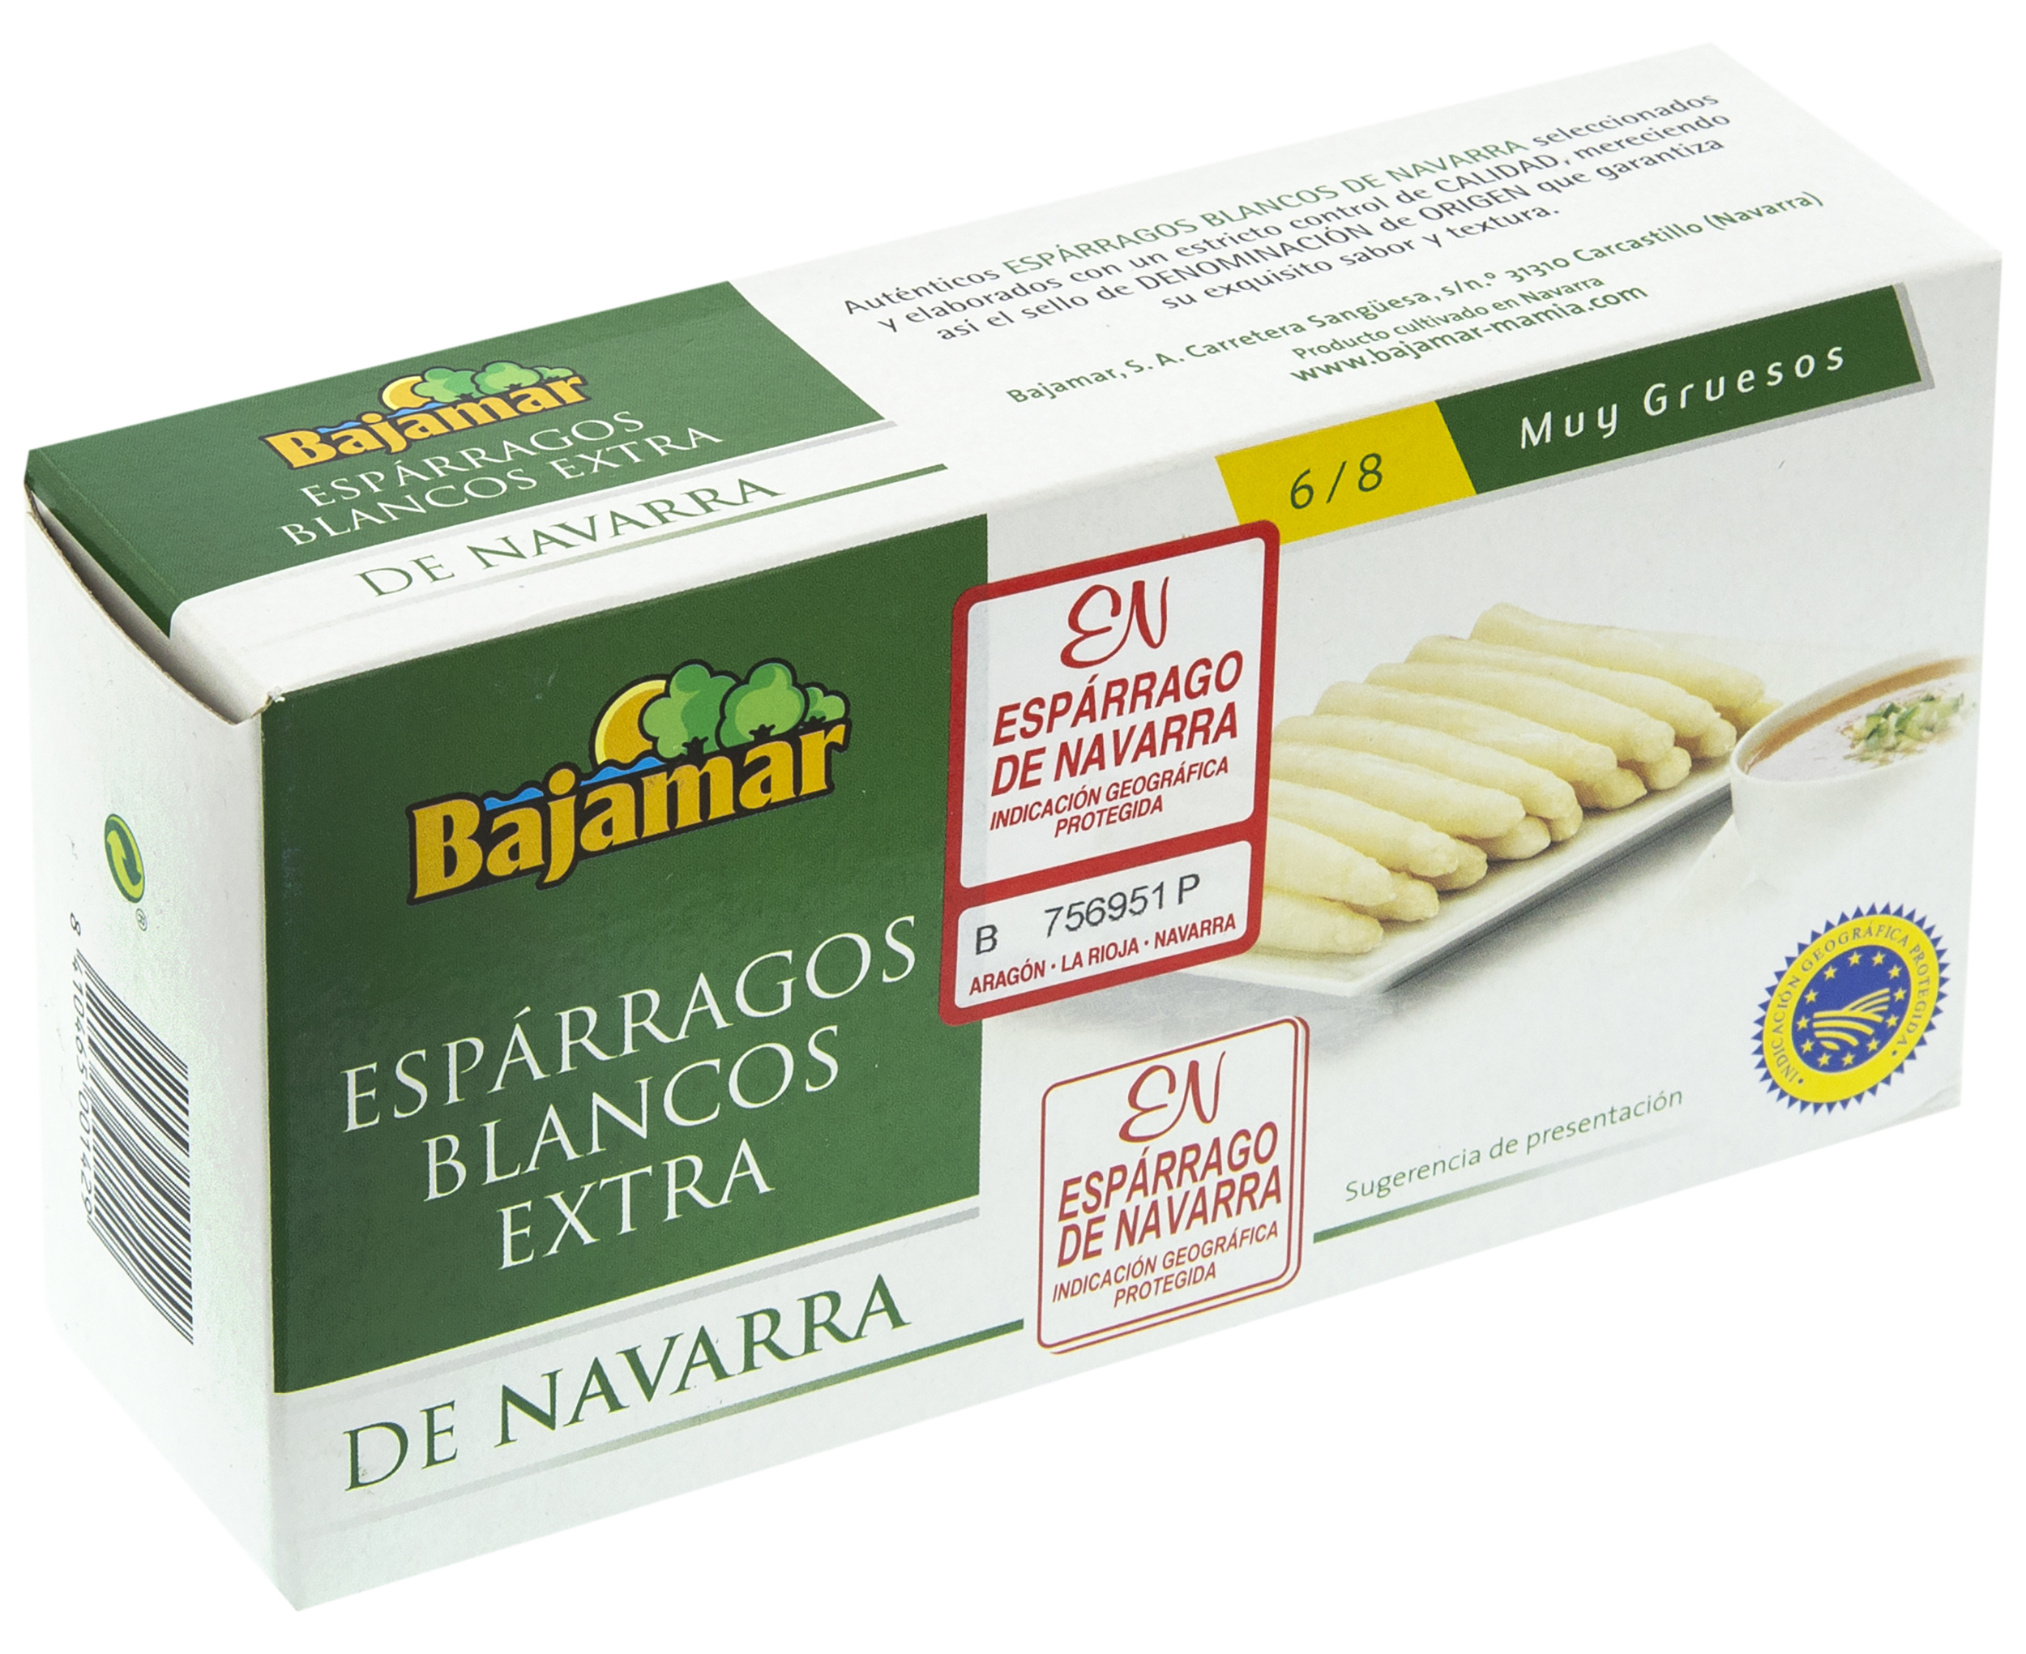
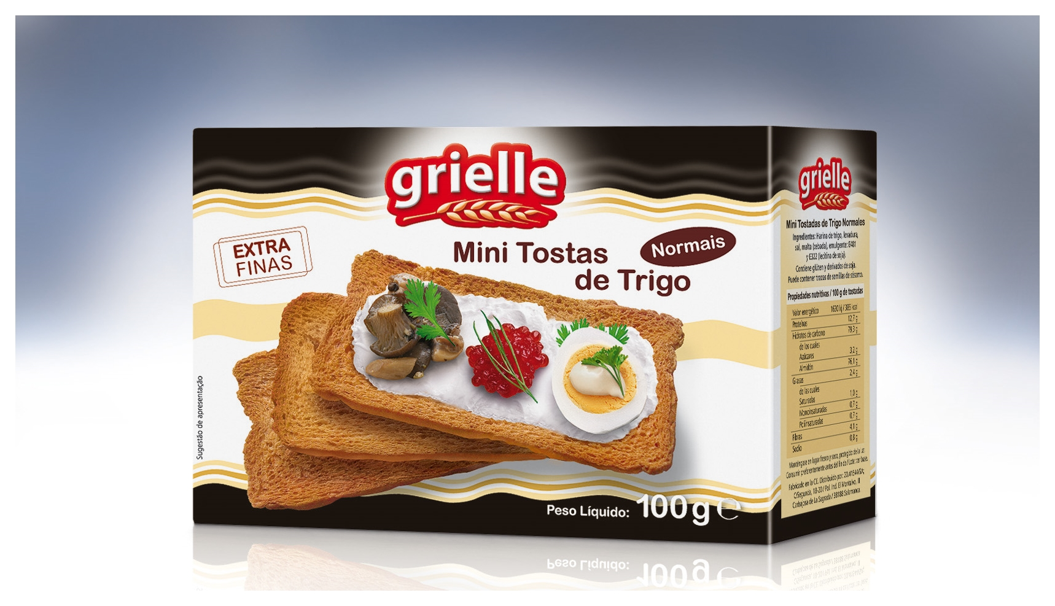
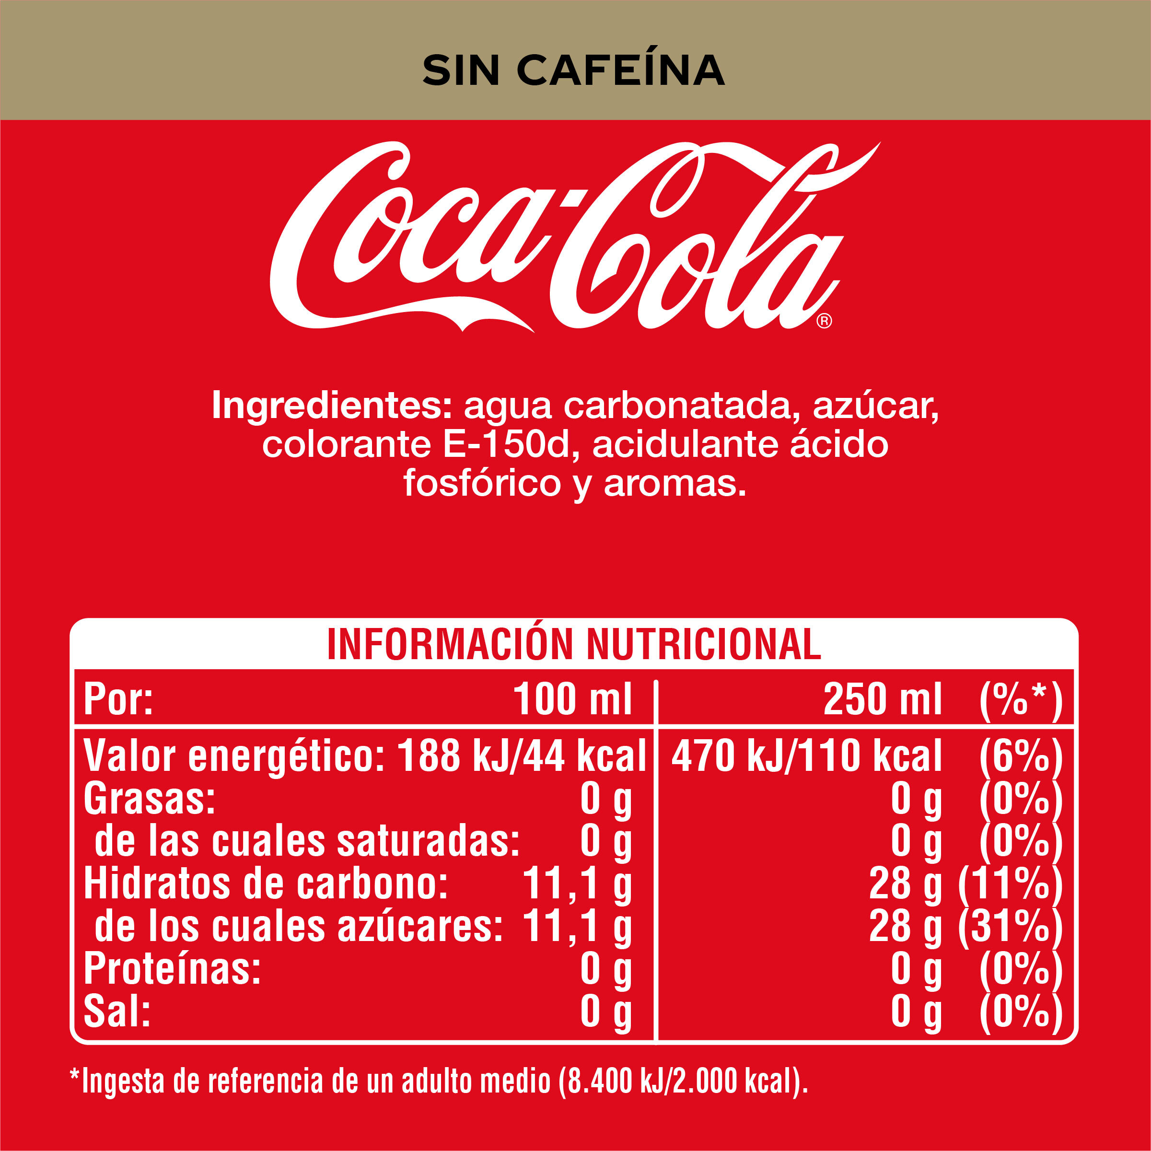
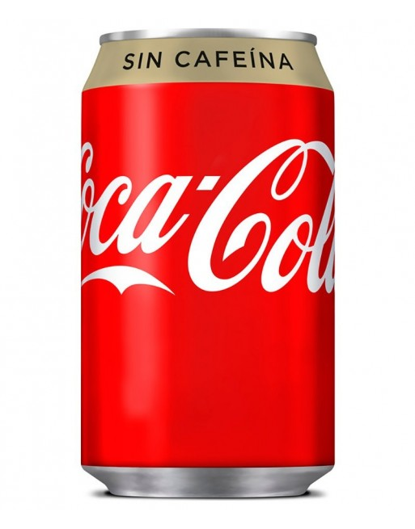
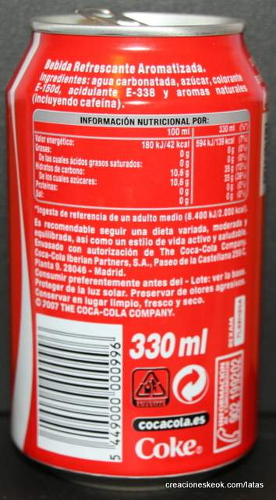
Image characteristics
Product Images
Different background colors:
white (pure) /non-white
Different types of packaging:
cylindrical (cans, cans, bottles), bricks/boxes, bags, packed with cling film
Images with different perspectives:
where full tags are displayed, where they are partially visible, and where they are not visible

Slide 9
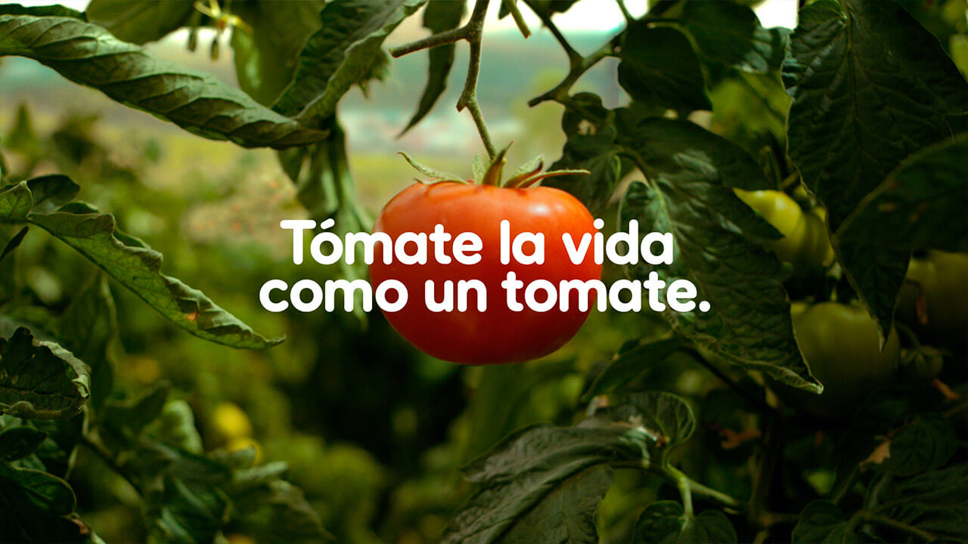
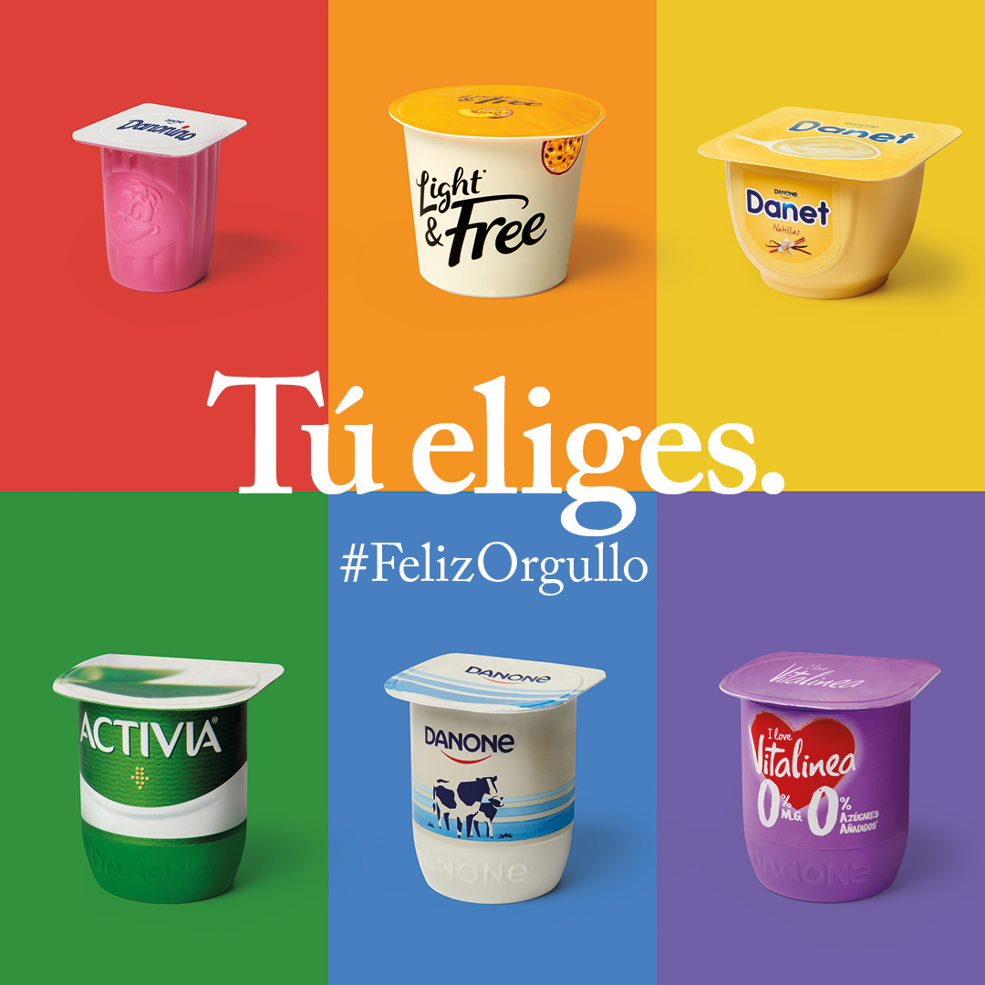
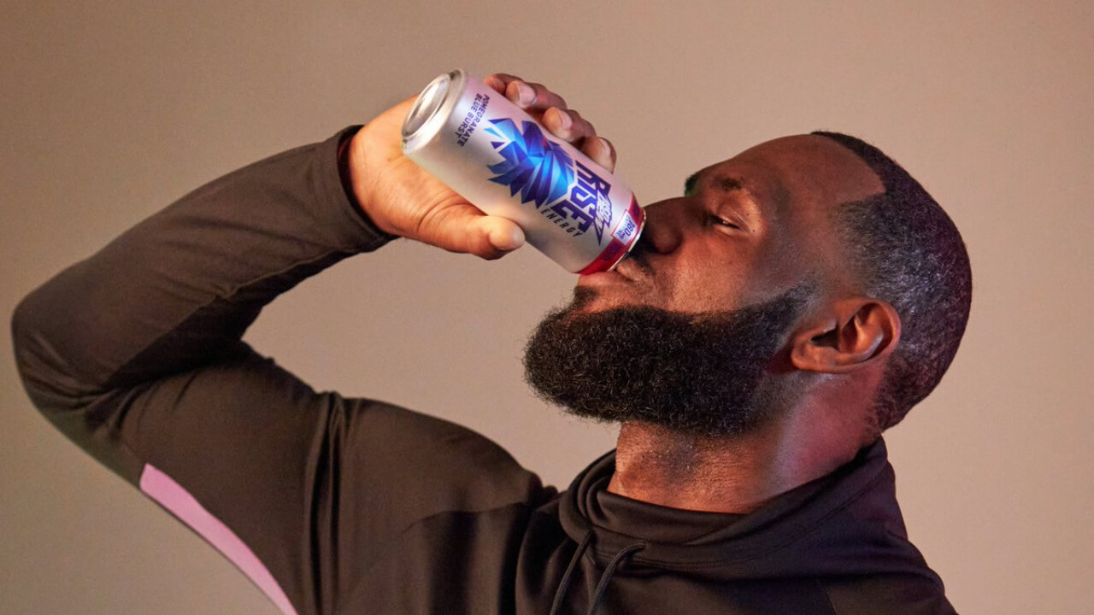
Image characteristics
Marketing images (optional)

Slide 10
Some tips
You are trying to sell a technology consulting project to a major client. Meet the client's requirements and try to add value to the project proposal and your solutions. Be creative! Analyze well the consequences and scalability of your solutions. Try to follow best practices when programming.

Slide 11
Contact information
Elvira.Alonso.Gonzalez1@ibm.com
Maher.elouahabi@viewnext.com
gines_carrascal@es.ibm.com

